Slide 1
CSE4255 Cellular Network
Lecture 6
Interference and System Capacity

Slide 2
Interference
Interference is anything which alters, modifies, or disrupts a signal.
It limits capacity and increases the number of dropped calls.
Sources of interference include
Another mobile in the same cell.
A call in progress in a neighboring cell.
Other base stations operating in the same frequency band.
Non-cellular systems leaking energy into cellular frequency band.
Notes:
1) It changes the original signal
2) Limiting factor: It limits capacity and increases the number of dropped calls.
Source of interference details in Interference folder .doc file

Slide 3
Effects of interference:
Interference on voice channels can cause cross-talks and noise in the background.
Interference on control channels causes missed calls and blocked calls due to errors in the digital signaling.
Types of Interference
Co-channel Interference (CCI)
Adjacent Channel Interference (ACI)
Notes:
Limiting factor: It limits capacity and increases the number of dropped calls.

Slide 4
Co-channel Interference (CCI)
The cells that use the same set of frequencies are called co-channel cells.
The interference between signals from these cells is called Co-Channel Interference (CCI).
Cannot be controlled by increasing carrier power of a transmitter. Rather, this will increase CCI.
To reduce co-channel interference, co-channel cells must be physically separated by a minimum distance.
Notes:
Unlike thermal noise which can be overcome by increasing the signal-to-noise ratio (SNR), co-channel interference cannot be combated by simply increasing the carrier power of a transmitter.

Slide 5
Reuse Distance Calculation
D = minimum distance between centers of cells that use the same band of frequencies (called co-channels)
R = radius of a cell
d = distance between centers of adjacent cells (d = )
N = number of cells in repetitious pattern
Reuse factor
Each cell in pattern uses unique band of frequencies
Hexagonal cell pattern, following values of N possible
N = i² + j² + ij, i, j = 0, 1, 2, 3, …
Possible values of N are 1, 3, 4, 7, 9, 12, 13, 16, 19, 21, …
D/R=
D/d =

Slide 6
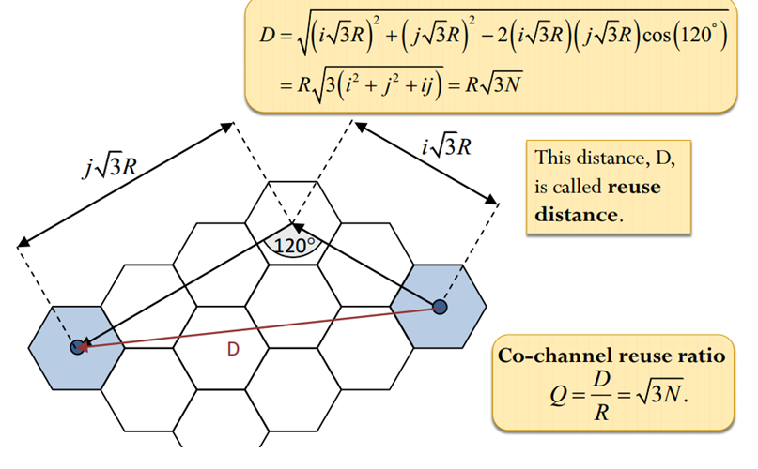
Reuse Distance Calculation
Figure 3: Resue Distance Calculation

Slide 7
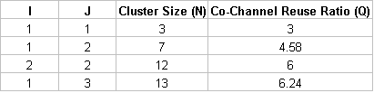
Co-channel Reuse Ratio
Q = D/R = co channel reuse ratio = the spatial separation between co-channel cells relative to the coverage distance of a cell.
Q is related to the cluster size(N) for a hexagonal geometry, Q = D/R =
A smaller value of Q provides a larger capacity but a higher co-channel interference.
Notes:
A small value of Q provides larger capacity since the cluster size N is small,
whereas a large value of Q improves the transmission quality, due to a smaller level of co-channel interference.

Slide 8
Example: 1
You are trying to design a cellular network that will cover an area of at least 2800 km². There are K=300 available voice channels. Your design is required to support at least 100 concurrent calls in each cell. If the co-channel cell centre distance is required to be 9 km, how many base stations will you need in this network?
Solution:
If 100 concurrent voice calls must be supported in each cell, each cell must be allocated 100 voice channels.
This necessitates the frequency re-use factor, N, to be 300/100=3.
The distance between co-channel cell centers D is related to R and N via the formula:
D = 9 km, then, R = 3 km
cell area is
2800/23.38 = 120 base stations are required

Slide 9

Signal to Interference Ratio/SIR
Signal to Interference Ratio is the ratio between the desired signal power (S) from desired base station and the interference power (I_{i}) caused by i^{th} interfering co-channel cell base station.
SIR = S/ I
=
i_{o} = number of co-channel interfering cells

Slide 10
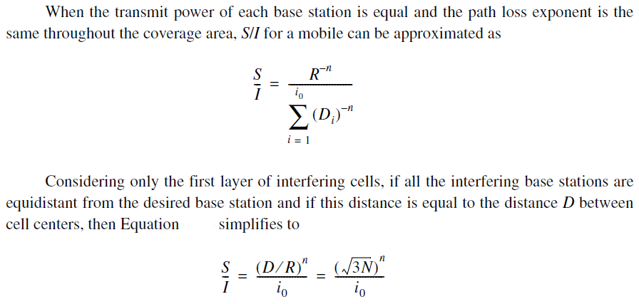
SIR for BS/ MS at the center:

Slide 11
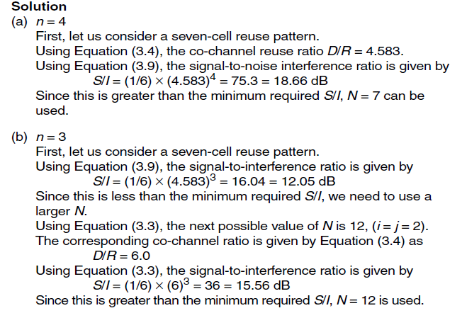
Example-2:
If a SIR of 15 dB is required for satisfactory forward channel performance of a cellular system, what is the frequency reuse factor and cluster size that should be used for maximum capacity if the path loss exponent is (a) n = 4, (b) n = 3? Assume that there are six co-channel cells in the first tier, and all of them are at the same distance from the mobile. Use suitable approximation.

Slide 12
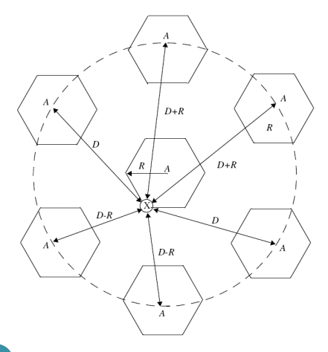


SIR for MS at the boundary of the cell:
Notes:
S = desired signal power.
d_{o} = R because mobile is R distance apart at picture.

Slide 13
Adjacent Channel Interference (ACI)
Interference resulting from signals which are adjacent in frequency to the desired signal is called adjacent channel interference.
It occurs when mobile phones in the same cell transmitting signals at different but close (adjacent) frequencies.
Adjacent Channel interference is only a reverse channel problem.
Notes:
This interference is not from adjacent cell mobile signal. It is within the cell allocating channel which could be interfere.
We know that each cell is given only a fraction of the available channels. This channels are called adjacent channel.
A band-pass filter, also bandpass filter or BPF, is a device that passes frequencies within a certain range and rejects (attenuates) frequencies outside that range.

Slide 14
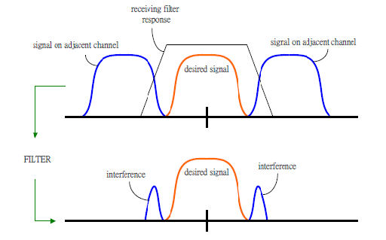
Reason for ACI
Adjacent channel interference results from imperfect receiver filters which allow nearby frequencies to leak into the passband.
Notes:
Real filters never have zero‐width transition bands (the width of the region between the passband and the stopband is never equal to zero) and their stopband levels are never zero (the filters attenuate the undesired signals but not completely).

Slide 15
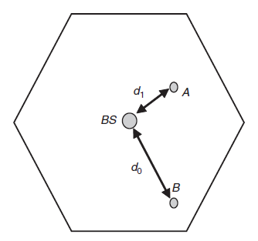


ACI Problem: Near-Far Effect:
When an interferer close to the base station radiates in the adjacent channel while the subscriber is actually far away from the base station.
If a subscriber is at a distance d_{o} and the interferer is at a distance d₁, then the signal to interference ratio prior to filtering is given by

Slide 16

Example-3:
Suppose the subscriber is at a distance of 1000 m from the BS and another mobile which is using an adjacent channel is unfortunately at a distance of only 100 m from the base station.
-40dB

Slide 17
Solving ACI: Channel Assignment
The solution to the problem of ACI is to insure that non of the channels assigned to a specific cell are adjacent.
For a cluster size of N = 7 , for example, distribute the channels of the system among different cells in the cluster such that the following channels are allocated to the different cells:
Cell 1 gets Channels 1, 8, 15, 22, 29, 36, …
Cell 2 gets Channels 2, 9, 16, 23, 30, 37, …
Cell 3 gets Channels 3, 10, 17, 24, 31, 38, …
Cell 4 gets Channels 4, 11, 18, 25, 32, 39, …
Cell 5 gets Channels 5, 12, 19, 26, 33, 40, …
Cell 6 gets Channels 6, 13, 20, 27, 34, 41, …
Cell 7 gets Channels 7, 14, 21, 28, 35, 42, …
Notes:
How to reduce?
Careful filtering
Channel assignment→ no channel assignment which are all adjacent in frequency.
Keeping frequency separation between each channel in a given cell as large as possible.

Slide 18
Power Control for Reducing Interference
Ensure each mobile transmits the smallest power necessary to maintain a good quality link on the reverse channel
– long battery life
– increase SIR
– solve the near-far problem
Types of Power Control:
Closed Loop Power Control
Open Loop Power Control

Slide 19
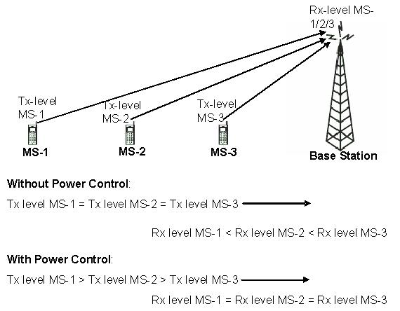

Slide 20
Closed-loop Power Control
Adjusts signal strength in reverse channel (MU to BS) based on some metric of performance in that reverse channel, such as
Received signal power level
Received signal-to-noise ratio, or
Received bit error rate
BS makes power adjustment decision and communicates to MU on control channel
Closed loop power control is also used to adjust power in the forward channel.
Notes:
Reverse channel = MS to BS
Forward channel = BS to MS

Slide 21
Open-loop Power Control
Depends solely on mobile unit with no feedback from BS
Use spread spectrum systems (SSS) where the BS continuously transmits an un modulated signal known as a pilot.
The MU monitors the RSS of the pilot and sets the transmitted power in the reverse (mobile to BS) channel.
Not as accurate as closed-loop, but can react quicker to fluctuations in signal strength

Slide 22
Problem 1:
Consider two different cellular systems that share the following characteristics. The frequency bands are 825 to 845 MHz for mobile unit transmission and 870 to 890 MHz for base station transmission. A duplex circuit consists of one 30-kHz channel in each direction. The systems are distinguished by the reuse factor, which is 4, and 19, respectively.
Suppose that in each of the systems, the cluster of cells (4, 19) is duplicated 16 times. Find the number of simultaneous communications that can be supported by each system.
Find the number of simultaneous communications that can be supported by a single cell in each system.
What is the area covered, in cells, by each system?
Suppose the cell size is the same in all two systems and a fixed area of 100 cells is covered by each system. Find the number of simultaneous communications that can be supported by each system.

